Slide 1
Understanding BIG DATA
Simon Dale, 27th September 2019
Notes:
14:45

Slide 2

BIG DATA
Big data is data sets that are so voluminous and complex that traditional data-processing application software are inadequate to deal with them.
Big data challenges include capturing data, data storage, data analysis, search, sharing, transfer, visualization, querying, updating, information privacy and data source.

Slide 3

VOLUME
The CERN Data Centre passed a major milestone on 29 June 2017 with more than 200 petabytes of data now archived on tape.
Particles collide in the Large Hadron Collider (LHC) detectors approximately 1 billion times per second, generating about one petabyte of collision data per second.
Even after the drastic data reduction performed by the experiments, the CERN DC processes on average one petabyte of data per day.
Notes:
https://home.cern/news/news/computing/cern-data-centre-passes-200-petabyte-milestone

Slide 4

VELOCITY
With Office 365 data there is much data velocity. It’s very high frequency data with 10 terabytes (TB) stored a day.

Slide 5

VARIETY
Variety in Big Data refers to all the structured and unstructured data that has the possibility of getting generated either by humans or by machines.

Slide 6

VERACITY
Veracity is all about making sure the data is accurate, which requires processes to keep the bad data from accumulating in your systems.

Slide 7

VALUE
The primary reason why Big Data has developed rapidly over the last years is because it provides long-term enterprise value.
Value is captured both, in terms of immediate social or monetary gain, and in the form of a strategic competitive advantage.

Slide 8

DATA STRATEGY
Define and understand problem domain
Data resources positioned effectively
Identify, store, provision, process, govern
Data inventory, protection and architecture
Lives and evolves alongside long term plan
Road-map to unlock value streams

Slide 9

DATA
90% of world data created in last 2 years
Relational Databases
Structured
NoSQL Data
JSON
XML
CSV
Semi-Structured
Unstructured
Email
Documents
Video
Web Page
Audio
Social Media
80% of modern data is unstructured

Slide 10

SQL
Model relationships between entities
Normalization, optimizations
Organization of data into:
Table (relation)
Column (attribute)
Row (tuple)
Attribute
Tuple
Relation

Slide 11

NOSQL
{X} | Document
XML | JSON | YAML
The central concept is the document. Assume that documents capture or encode all data. Often encoded as XML, JSON or YAML.
MongoDB | CouchDB | RavenDB
[X,Y,Z] | Column
PARQUET | ORC | DELTA
Data arranged with data stored in columns. A timestamp is used to differentiate current and stale records. Many columns form a Column Collection.
Cassandra | HBase | Accumulo
-[X]-> | Graph
CIPHER | GREMLIN
Uses graph structures and semantic queries. Nodes and edges with properties are used to represent data and relationships.
Neo4J | Tinkerpop | JanusGraph
[X=Y] | Key Value
HASH | DICTIONARY
A data store designed for storing, retrieving and managing associative arrays. Records are quickly retrieved via a unique key.
Redis | Riak| Oracle NoSQL
{X::Y} | Object
C# | JAVA | JS
A database management system in which information is represented as objects as used in an object-oriented language.
db4o | JADE| ObjectDB

Slide 12
METADATA
Information about Information
Descriptive
Owner
Meaning
Purpose
Administrative
Access
Lifetime
Origin
Structural
Relationships
Organisation
Keys

Slide 13

CAP THEOREM
When designing distributed web services, there are three properties that are commonly desired: consistency, availability, and partition tolerance. It is impossible to achieve all three.
PACELC goes further, another trade-off also exists: between latency and consistency, even in absence of partitions, providing a more complete portrayal of consistency tradeoffs for distributed systems.
Availability
Consistency
Partitioning

Slide 14















DATA ECOSYSTEM

Slide 15







DATA ECOSYSTEM

Slide 16
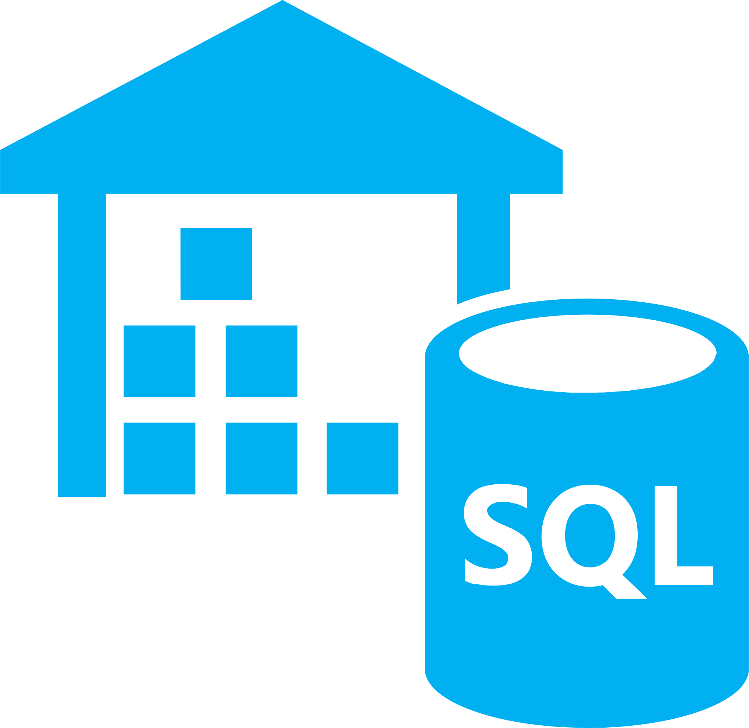




DATA ECOSYSTEM

Slide 17



DATA ECOSYSTEM

Slide 18

LAB #1 STORAGE & INGESTION

Slide 19

INGESTION
The start of the “Data Supply Chain”
Transfer and Loading of Data to a Repository
How much data to ingest?
How quickly is data ingested?
How accurate is ingested data?
Who accesses the data?
AirFlow | Sqoop | Azure Data Factory | AWS Glue

Slide 20

ETL / ELT
Movement of data into the data platform
Different strategies for different work loads
When is structure applied to data?
How often does structure change?
Which users consume data?
ETL
Extract | Transform | Load
OLAP/SSIS Vertical Scale Specific transforms Data warehousing Up-front investment
ELT
Extract | Load | Transform
Horizontal Scale Transform on-demand Data lakes Unlimited potential

Slide 21

STORAGE
Hadoop File System (HDFS)
Azure Storage Accounts (WASBS/ABSFS)
AWS S3 Buckets (S3A)
Parquet Columnar Files
Databricks Delta
Apache Avro

Slide 22

LAB #2 BATCH DATA PROCESSING

Slide 23

COMPUTE
Hadoop | Spark | Hive | MapReduce | Presto

Slide 24

BATCH PROCESSING
Map
Shuffle
Reduce

Slide 25

LAB #3 STREAM PROCESSING

Slide 26

STREAMING
Real-time / near real-time processing
Rich metadata derived from stream
Time windowed operations
Build and define streaming topology

Slide 27

TEMPORAL WINDOWS
Tumbling Window
Process a batch every X units of time
Perform a function against discreet stream segments
0
5
10
15
20
25
30
Hopping Window
Process a batch of X units duration every Y units of time
Perform a function against overlapping stream segments
0
5
10
15
20
25
30
Sliding Window
Process a batch of X units duration for every element
Perform a function against uniform segments, only when elements arrive
0
5
10
15
20
25
30

Slide 28

RESULTS
Analytic datacentres
Result sets to serve specific queries
Star schema
Multi-dimensional cube

Slide 29




LAB #4 INTELLIGENT VISUALISATION

Slide 30
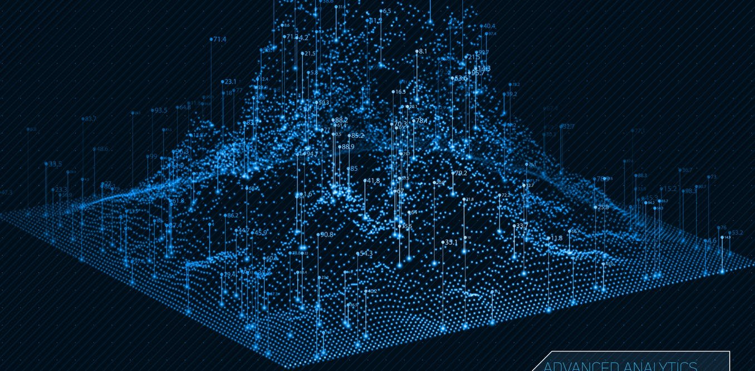
VISUALIZATION
Collaboration through notebooks
Jupyter
Zeppelin
Databricks
Rich dashboards
Tableau
PowerBI
Grafana
Result set caching

Slide 31

REVIEW & QUESTIONS

